Slide 1
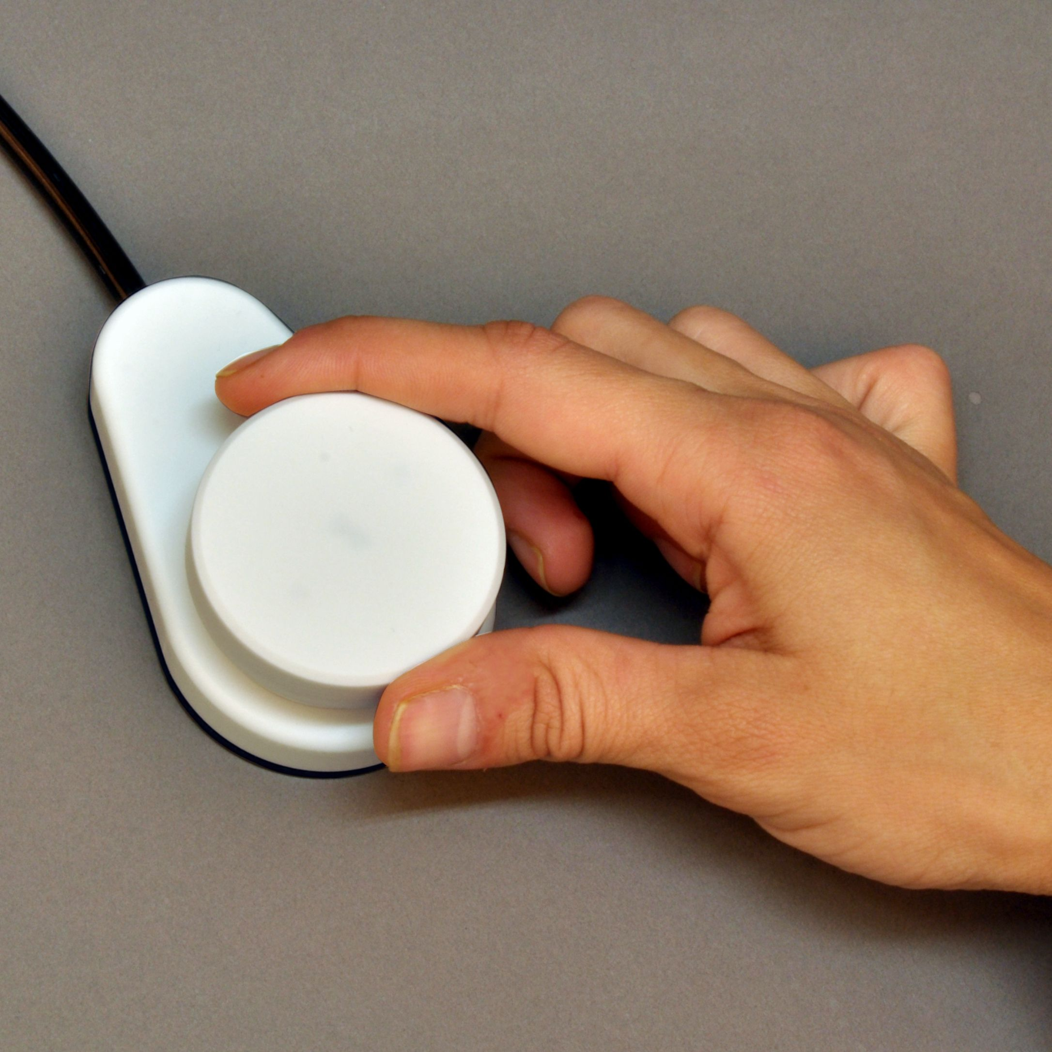
Position your hands so that your
thumb and index finger wrap around the dial knob.
KEEP ROTATING TO THE RIGHT TO CONTINUE

Slide 2

NCAIR Task
Practice: Run 1
KEEP ROTATING TO THE RIGHT TO CONTINUE
Notes:
Outside the scanner

Slide 3
NCAIR Task
Practice: Run 2
KEEP ROTATING TO THE RIGHT TO CONTINUE
Notes:
Outside the scanner

Slide 4
NCAIR Task
Practice: Run 3
PRESS THE RIGHT BUTTON TO CONTINUE
Notes:
Outside the scanner

Slide 5
NCAIR Task
Scan: Run 1
RIGHT HAND
KEEP ROTATING TO THE RIGHT TO CONTINUE
Notes:
Outside the scanner

Slide 6
NCAIR Task
Scan: Run 2
RIGHT HAND
KEEP ROTATING TO THE RIGHT TO CONTINUE
Notes:
Outside the scanner

Slide 7
NCAIR Task
Scan: Run 3
RIGHT HAND
KEEP ROTATING TO THE RIGHT TO CONTINUE
Notes:
Outside the scanner

Slide 8
NCAIR Task
Scan: Run 4
RIGHT HAND
KEEP ROTATING TO THE RIGHT TO CONTINUE
Notes:
Outside the scanner

Slide 9
NCAIR Task
Scan: Run 5
RIGHT HAND
PRESS THE RIGHT BUTTON TO CONTINUE
Notes:
Outside the scanner

Slide 10
NCAIR Task
Scan: Run 6
RIGHT HAND
PRESS THE RIGHT BUTTON TO CONTINUE
Notes:
Outside the scanner

Slide 11
When you are ready,
Keep rotating the dial to the right to continue.
Notes:
Add screenshots of an X and an O screen – like a timeline of screenshots.

Slide 12
This is the same task as the one you just completed.
KEEP ROTATING TO THE RIGHT TO CONTINUE
Notes:
Add screenshots of an X and an O screen – like a timeline of screenshots.

Slide 13
This is the same task as the one you just completed.
PRESS THE RIGHT BUTTON TO CONTINUE
Notes:
Add screenshots of an X and an O screen – like a timeline of screenshots.

Slide 14
When you are ready,
Keep rotating the dial to the right to continue.
Notes:
Add screenshots of an X and an O screen – like a timeline of screenshots.

Slide 15


In this task, you watch a series of videos. Use the dial to indicate how much each video relates to your identity as a Native Person
The dial controls a meter at the bottom right corner like this:
Use the dial to give your rating ongoing throughout each video.
100
50
0
0 = No connection to your identity at all
100 = Completely connected to your identity
KEEP ROTATING TO THE RIGHT TO CONTINUE
Notes:
Add screenshots of an X and an O screen – like a timeline of screenshots.

Slide 16
Identity: how much did this video relate to your identity as a native person (0-100)
[insert number line 0-100controlled by dial]
Notes:
Add screenshots of an X and an O screen – like a timeline of screenshots.

Slide 17
Valence: Rate your mood in response to this video.
[insert likert scale 1-9 with anchors 1=negative 5= neutral 9= positive]
Notes:
Add screenshots of an X and an O screen – like a timeline of screenshots.

Slide 18
Arousal: Rate your arousal in response to this video.
[insert likert scale 1-9 with anchors 1=calm 5= middle 9= excited]
Notes:
Add screenshots of an X and an O screen – like a timeline of screenshots.

Slide 19
In this task, you listen to music clips. Use the dial to indicate how much each clip relates to your identity as a Native Person
The dial controls a meter at the bottom right corner like this:
Use the dial to give your rating ongoing throughout each video.
100
50
0
0 = No connection to your identity at all
100 = Completely connected to your identity
KEEP ROTATING TO THE RIGHT TO CONTINUE
Notes:
Add screenshots of an X and an O screen – like a timeline of screenshots.

Slide 20
At the end of each clip, you will respond to three questions:
Identity: how much did this clip relate to your identity as a native person (0-100)
Valence: Rate your mood in response to this clip. (1-9) 1= negative 5= neutral 9=positive
Arousal: Rate your arousal in response to this clip. (1-9) 1= calm 5= middle 9=excited
KEEP ROTATING TO THE RIGHT TO CONTINUE
Notes:
Add screenshots of an X and an O screen – like a timeline of screenshots.

Slide 21
When you are ready,
Keep rotating the dial to the right to continue.
Notes:
Add screenshots of an X and an O screen – like a timeline of screenshots.

Slide 22
Identity: how much did this clip relate to your identity as a native person (0-100)
[insert number line 0-100controlled by dial]
Notes:
Add screenshots of an X and an O screen – like a timeline of screenshots.

Slide 23
Valence: Rate your mood in response to this clip.
[insert likert scale 1-9 with anchors 1=negative 5= neutral 9= positive]
Notes:
Add screenshots of an X and an O screen – like a timeline of screenshots.

Slide 24
Arousal: Rate your arousal in response to this clip.
[insert likert scale 1-9 with anchors 1=calm 5= middle 9= excited]
Notes:
Add screenshots of an X and an O screen – like a timeline of screenshots.

Slide 25
In this task, you will see a series of pictures in sets of four. After each set of images, you will be asked to respond to three questions:
Identity: how much did these pictures relate to your identity as a native person (0-100)
Valence: Rate your mood in response to these pictures. (1-9) 1= negative 5= neutral 9=positive
Arousal: Rate your arousal in response to these pictures. (1-9) 1= calm 5= middle 9=excited
PRESS THE RIGHT BUTTON TO CONTINUE
Notes:
Add screenshots of an X and an O screen – like a timeline of screenshots.

Slide 26
When you are ready,
Press the right button to continue.
Notes:
Add screenshots of an X and an O screen – like a timeline of screenshots.

Slide 27
Identity: how much did these pictures relate to your identity as a native person (0-100)
[insert number line 0-100 controlled by buttons]
Notes:
Add screenshots of an X and an O screen – like a timeline of screenshots.

Slide 28
Valence: Rate your mood in response to these pictures.
[insert likert scale 1-9 with anchors 1=negative 5= neutral 9= positive]
Notes:
Add screenshots of an X and an O screen – like a timeline of screenshots.

Slide 29
Arousal: Rate your arousal in response to these pictures.
[insert likert scale 1-9 with anchors 1=calm 5= middle 9= excited]
Notes:
Add screenshots of an X and an O screen – like a timeline of screenshots.

